Slide 1
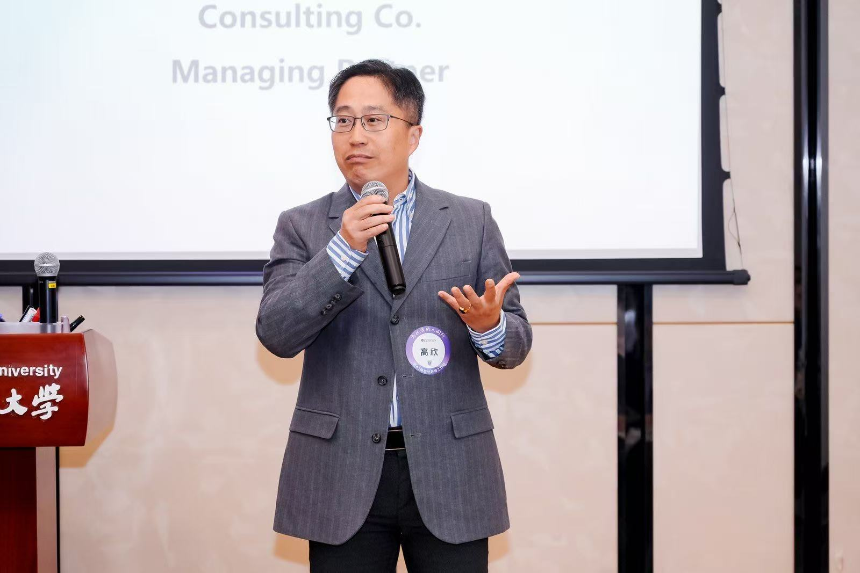
Some Facts
Seasoned professional in Human Resource Management, offering comprehensive HR consulting services from strategic design to operational execution, covering various industries.
Member of WorldatWork and GPMIP.
Speaker of the Year, 2019 HREC.
Certified Visiting Lecturer at Xi'an Jiaotong-Liverpool University.
            Career Experience
              Worked at MNCs including Kraft, Baxter, Coca-Cola, Honeywell, Lucent, NXP, J&, SAP.
              Served as (Senior) HR Director at SAP, NXP, and Reckitt.
              Held HR Manager roles at Coca-Cola, Honeywell, and Lucent.
              Expertise: Extensive experience across various facets of human resource management.

Slide 2
What makes me UNIQUE?
One takeaway learned at Reckitt (which I fully agree with) :
Leveraging your strengths is what ultimately drives success.
My key competencies and strengths:
Strong logic thinking, from rigorous mathematical training in early years.
  Consistently apply structured, analytical thinking to solve complex problems—delivering high-quality outcomes on time.
  Confidently build frameworks from scratch and design creative solutions when needed (e.g., pre-IPO LTI program design).
Thinking like a business owner rather than just a service provider
  All projects are delivered by putting long-term customer experience top priority, e.g. tailor-made toolkits, culture fit, long-tail follow up etc.
Solid know–how in how technologies empower management and process
  A rare combination of deep HR experience and technology expertise that enables smooth delivery of HR digital transformation initiatives.
Endless Curiosity
  Energized by new challenges and continuously motivated to learn
Extensive MNC HR experience across industries
  Although this is more like Facts not competencies, worth to mention my industry insight on Semicon, Software, Pharma, FMCG….

Slide 3
Projects Brief
21 VNET – Interim HR Mgmt, assigned by PE for 2nd IPO
Key challenges:
Unclear HR roles and responsibilities, incomplete policies and procedures, and lack of expert capabilities.
Key Deliverables:
On-site interim management for over 6 months.
Developed a state-of-the-art HR management framework covering all three Biz units.
Established and empowered a Group-level SSC and COE, enabling HRBPs to shift from operational tasks to strategic business partnering and better address unit-specific organizational and talent needs.
Conducted a comprehensive review of all HR functions and delivered 1:1 coaching to empower key stakeholders.
Created a unified Competency Model covering core functions across the Group, subsequently supporting talent pipelining in new BU.
Conducted a Talent Assessment Program for all key talents.
Led the deployment of a Learning Platform featuring progressive learning paths tailored to each role’s competency model.
Improved recruitment efficiency by optimizing collaboration with external platforms through digitized job profiles.

Slide 4
Projects Brief
Vale International – SSC Enablement + Digital Transformation, BD by self
Key Challenges:
HR operations remain country-specific despite clear harmonization benefits, which SSC mindset/digital tools—including but not limited to SuccessFactors—are expected to address.
Key Deliverables:
Led HR transformation project (extended to two years) for APAC + EMEA regions by using SAP SuccessFactors deployment as a handle of enhancing HR management framework.
Developed interfaces with Payroll and Attendance systems (ADP), to let SSC to quickly find their values under new platform
Coordinated integration testing by deeply involving ALL stakeholders
Directed HR Shared Service Center (SSC) in APAC/EMEA to drive data and process improvements via new tech, e.g. MS 365
Supported Total Rewards team in establishing more reliable compensation/ benefits framework across the region.
Assisted in refining the Y_E bonus process and set the rules for future
Coached HR colleagues in the SSC and Total Rewards teams.
Notes:
Customer Initial Requirements:
Assigned by Global HR to provide HR consulting service across APAC + EMEA, with focus on
Streamline HR organization by reviewing and coaching current HR team in COE+SSC
Work closely with global project team, to ensure SAP SF’s on time deployment in region
Deep Dive upon baseline investigation:
Current HR internal

Slide 5
Projects Brief
西凤 – HR Organization Enablement, BD by self
Key Challenges:
Business team lacks autonomy despite reliable execution
HR lacks HR expertise despite strong loyalty and passion
Organization lacks key revenue-driving units e.g. Marketing, Trade Marketing, and E-Trade to unlock further growth.
Key Deliverables:
Consulting Services with at least 2 years of long-tail tracking and support.
Developed a comprehensive HR framework, including organizational design and empowerment strategies, e.g. Workshops.
Designed a grading system to ensure competitive/fair compensation.
Implemented a goal-based performance management system for measurable outcomes of all key contributors.
Established a performance bonus system to reward achievements.
Created a commission system to incentivize sales and performance.
Introduced a long-term incentive plan to retain top talent.
Formulated a Talent Development Plan to enhance employee growth.
Developed a solid Management Trainee Program to nurture future leaders.
Built teams of Marketing, Trade Marketing and E-Trade with modern definitions.

Slide 6
Back-Ups

Slide 7
Projects Brief
A M&A project for an international logistic giant
Collaborated with GPMIP as the HR champion for the entire M&A project.
Conducted a deep-dive productivity analysis to identify key insights.
Designed an organizational blueprint based on a comprehensive analysis of both parties.
Proposed an HC optimization plan integrating bottom-up analysis with top-down financial expectations.
Performed talent assessments and staff assignments to align with the organizational blueprint, including before-and-after comparisons for HC and productivity.
Prepared communication decks tailored for management, managers, and employees.
Integrated HR strategies into the overall M&A proposal for seamless execution.

Slide 8
Projects Brief
A State-Owned Engineering Group
Customer Initial Requirements:
To find a smooth solution aiming at souring adequate proper technical engineers for ad-hoc projects
Deep Dive upon baseline investigation:
The talent pool are always existing in form of discrete staffing papers associated with historical projects
Need to build a system which is capable to
  Track useful competency information of existing engineers
  Collect information from new capture competency information in structured way
  Establish digital competency profile DB for all above
  Develop algorithm to match project demand quickly and accurately
  Track performance under each project and make it useful reference for future match

Slide 9
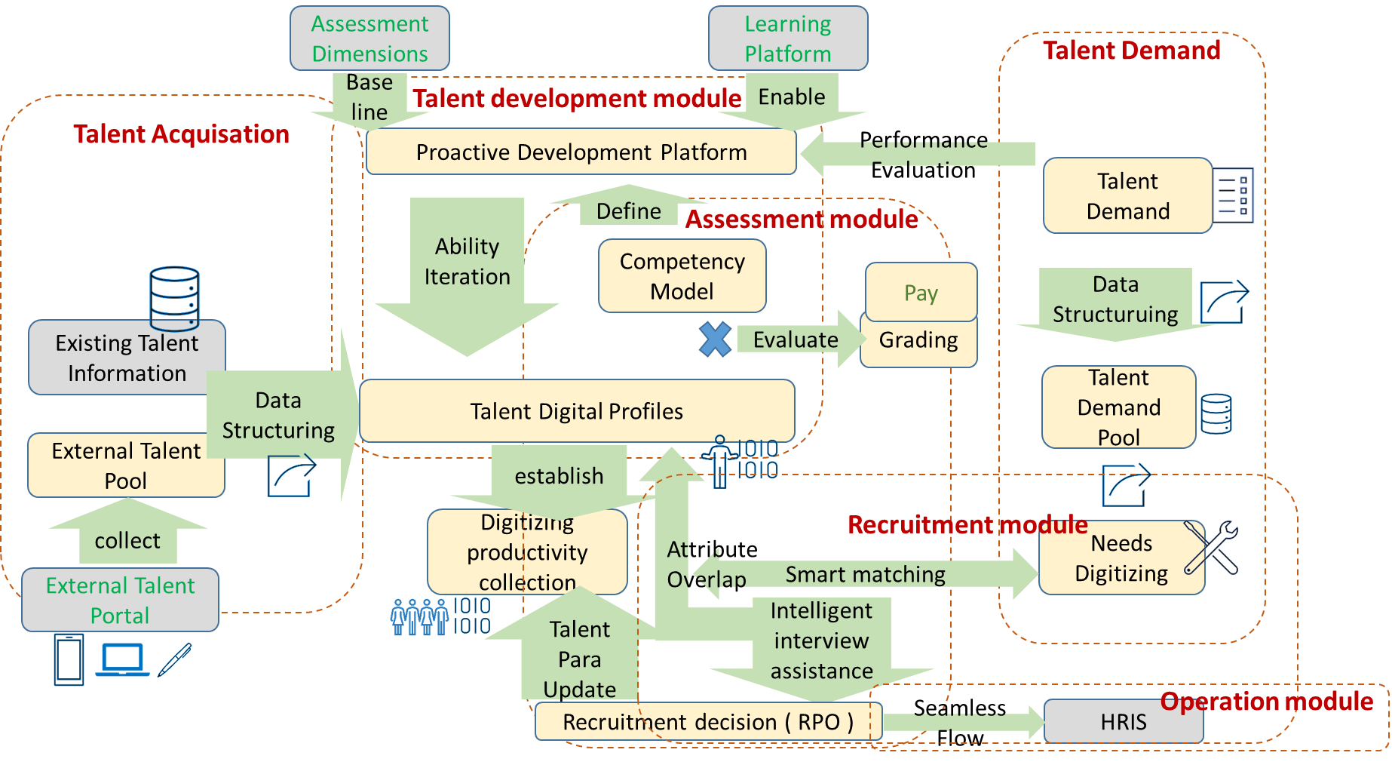
A State-Owned Engineering Group
What we Delivered – Talent Sourcing system Smartisans

Slide 10
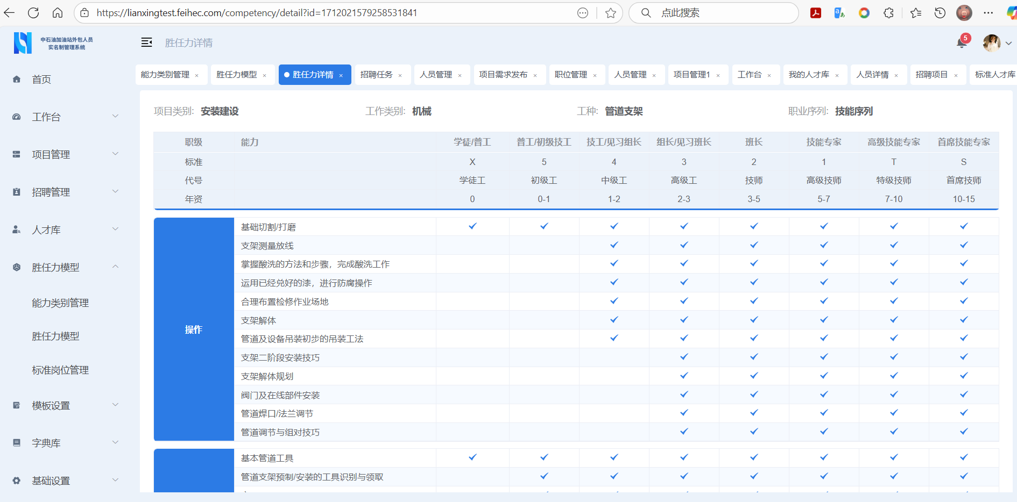
Projects Brief
A State-Owned Engineering Group
What we Delivered – Talent Sourcing system Smartisans

Slide 11
Projects Brief
An agricultural technology company
Constructed an overall HR framework to align with organizational goals.
Designed organizational structure and empowerment strategies to enhance efficiency.
Developed a grading and salary system to ensure equitable compensation.
Implemented a performance incentive program to motivate employees.
Designed a long-term incentive plan to retain key talent.
Launched a Talent Development Program to foster professional growth.
Established the Group's Shared Service Center to streamline HR operations.
Drove digital transformation to modernize HR processes.

Slide 12
Projects Brief
A dental chain enterprise
Developed an overall HR framework to support organizational objectives.
Designed organizational structure and empowerment strategies to enhance leadership
Implemented business-specific competency assessments and a digital patient allocation system for optimized resource management.
Created profit-sharing plans by clinic to foster an entrepreneurial spirit among staff.
Constructed a grading/salary system and designed performance incentives and long-term incentive plans to drive motivation and retention.

Slide 13
Projects Brief
Nation-Owned distribution group
Designed organizational structure for Marketing and Trade Marketing functions to align with market demands.
Managed new department staffing and development to build capable teams.
Conducted data mining from existing business systems to empower new functions with greater confidence.
Established a mature performance-based compensation management framework to incentivize productivity.
Facilitated deployment of the above initiatives through digital solutions for enhanced efficiency.

Slide 14
Projects Brief
21 VNET – Interim HR Mgmt, assigned by PE for 2nd IPO
Customer Initial Requirements:
Assigned by Invetor (PE), to provide Interim HR Management aiming at
  Build HR management framework by transforming/ enabling current HR team, in specific to realize 3 pillars structure
  Work closely with top management, to establish solid talent backbone for company’s secondary listing (new BU)
Key challenges upon Deep Dive:
Current HR team members mostly play hybrid role of business partner + function specialists, which lead to chaos and Inefficiency
There is no HRBP could really concentrate on business strategic supporting, especially identify talent shortage for upcoming new business unit
There is no authoritative COE to govern necessary rules
There is no dedicated SSC to ensure accurate executions

Slide 15
Projects Brief
21 VNET – Interim HR Mgmt
What Delivered
On-site interim management for over 6 months.
Developed a state-of-the-art HR management framework at the group level, encompassing all three distinct business units.
Established a Group SSC and COE to shift HRBPs' focus from operational tasks to strategic business partnering, to contribute against organizational and talent needs specific to each business Units.
Reviewed all HR functions and provided 1:1 coaching to empower relevant stakeholders.
Created a unified Competency Model covering key functions across the Group which can be used for talent pipelining in new BU.
Conducted a Talent Assessment Program for all key talents.
Led the construction of a Learning Platform, incorporating gradient learning plans tailored to the competency model of each position.
Enhanced recruitment efficiency by optimizing collaboration with external platforms using digitalized job profiles.

Slide 16
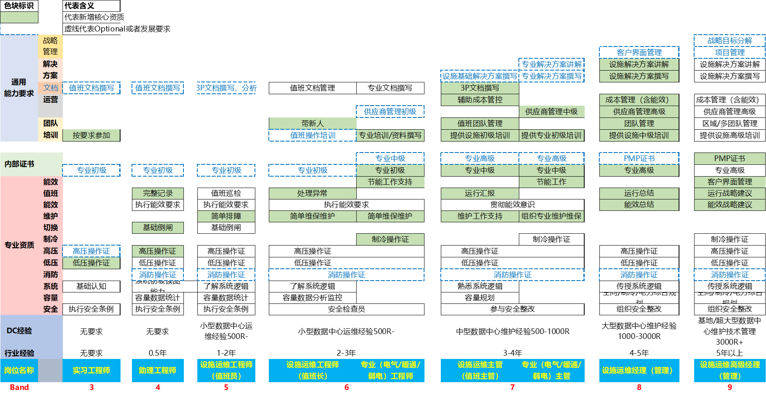
Projects Brief
21VNET(continued – typical products)
Competency Model Sample – Career Stream for IDC Engineering

Slide 17

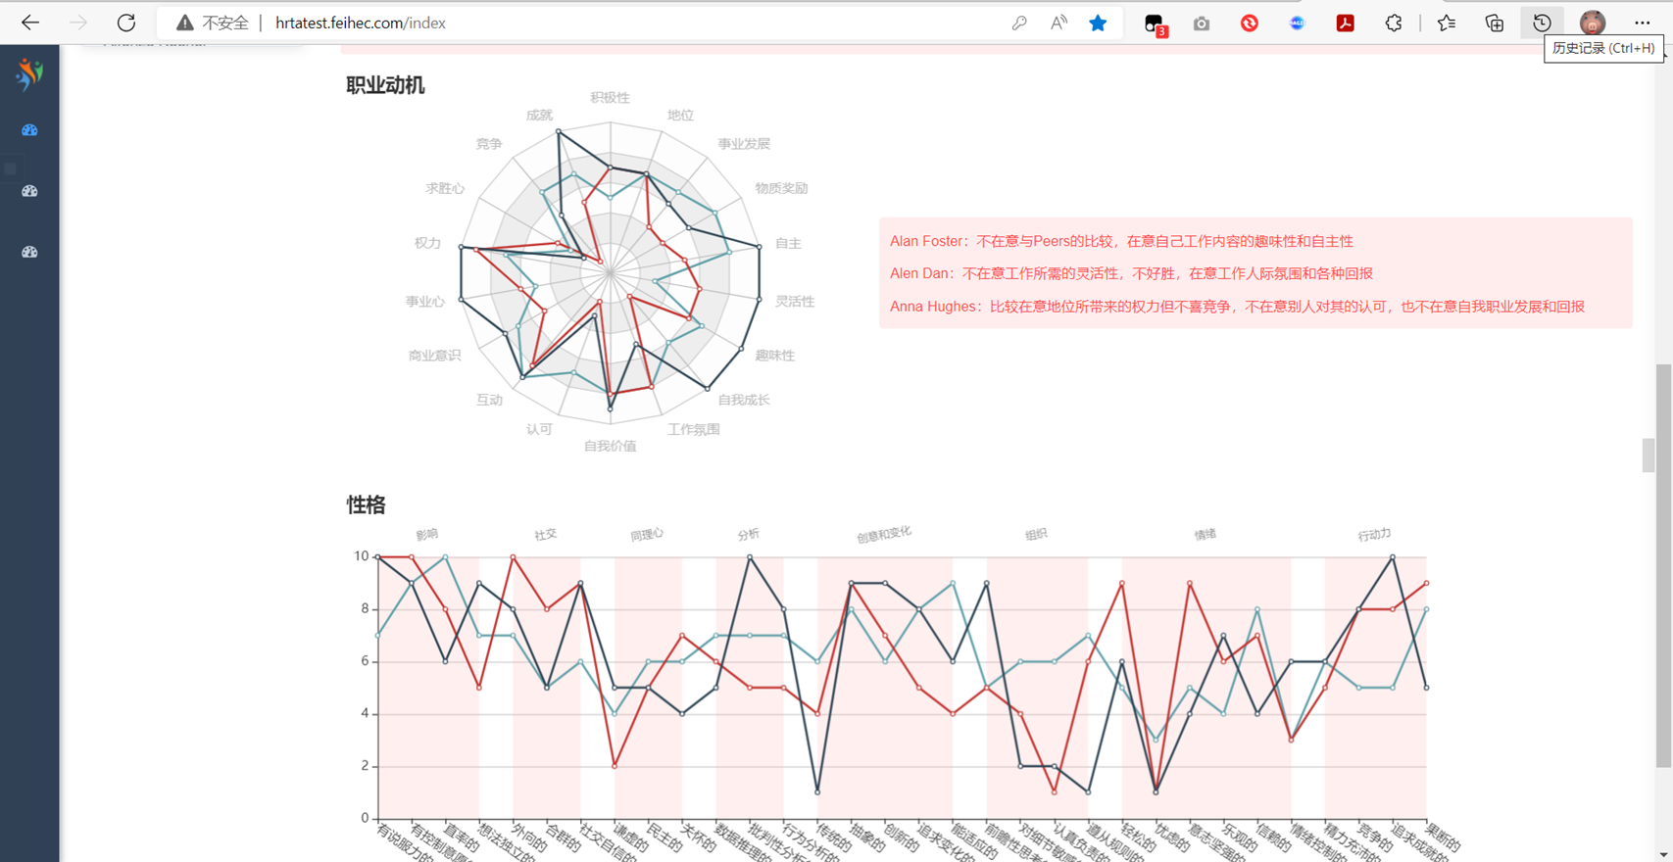
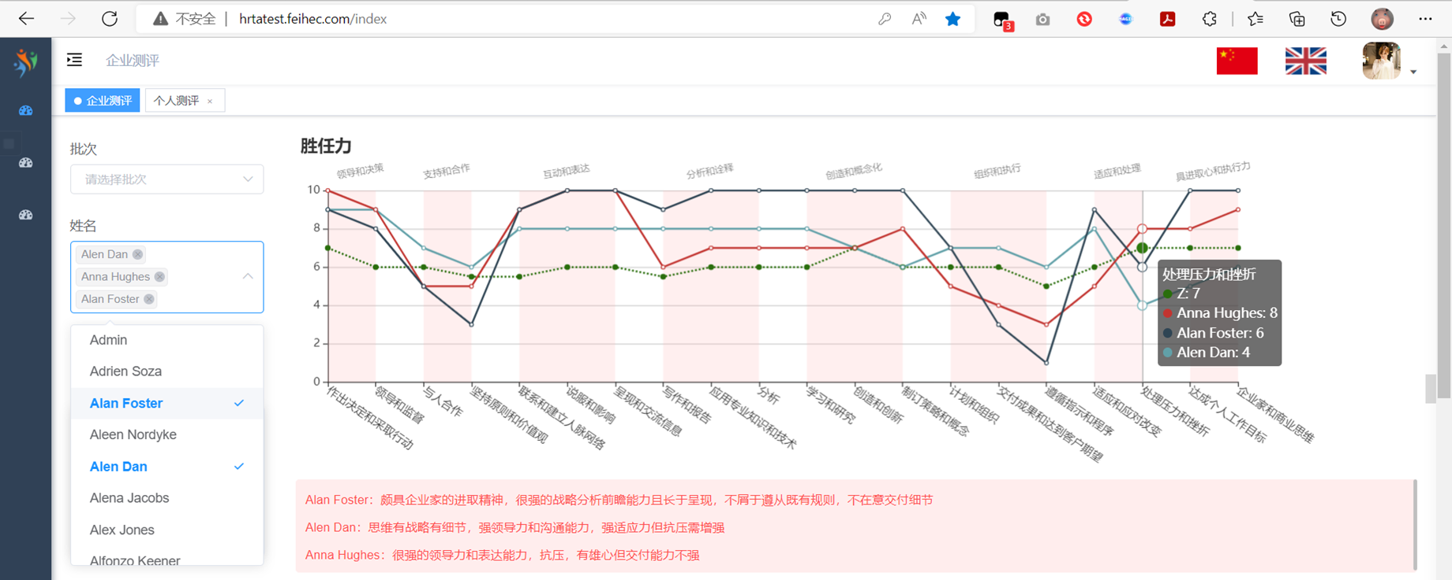
Projects Brief
21 VNET (continued – typical products)
Competency Based Talent Tracking System – SaaS

Slide 18
Projects Brief
Vale International – SSC Enablement + Digital Transformation
Customer Initial Requirements:
Assigned by Global HR to provide HR consulting service across APAC + EMEA, with focus on
  Streamline HR organization by reviewing and coaching current HR team in COE+SSC
  Work closely with global project team, to ensure SAP SF’s on time deployment in 2 regions
Deep Dive upon baseline investigation:
Current HR internal knowledge are managed almost offline by certain people, with confused understanding among team
SSC are very country focused (not really region SHARED) although we see huge value harmonizing most of practices across multiple countries
Lack of vehicles to help SSC to work in modern way
Low level of SSC engagements on SF deployment
Notes:
Customer Initial Requirements:
Assigned by Global HR to provide HR consulting service across APAC + EMEA, with focus on
Streamline HR organization by reviewing and coaching current HR team in COE+SSC
Work closely with global project team, to ensure SAP SF’s on time deployment in region
Deep Dive upon baseline investigation:
Current HR internal

Slide 19
Projects Brief
Vale International (continued)
What we Delivered
Led HR transformation project (extended to two years) for APAC + EMEA regions by using SAP SF deployment as a handle of enhancing HR management framework.
Developed interfaces with Payroll and Attendance systems (ADP), to let SSC to quickly find their values under new platform
Coordinated integration testing by deeply involving ALL SSC (plus HRBP+COE)
Directed HR Shared Service Center (SSC) in APAC/EMEA to drive data and process improvements via new tech, e.g. MS 365
Supported Total Rewards team in establishing more reliable compensation/ benefits framework across the region.
Assisted in refining the Year-End bonus process and set the rules for future
Coached HR colleagues in the SSC and Total Rewards teams.

Slide 20
Projects Brief
西凤 – HR Organization Enablement
Customer Initial Requirements:
Make HR a key driver to realize the goal of 2X revenue in 3 years
Establish HR team to support sustainable development of business
From organizational perspective review business structure to fir modern business environment
Deep Dive upon baseline investigation:
Current business team is very reliable on execution of superior’s command, while lack of self-motivation upon micro goals of own
Current HR team are led by business leader who is no doubt with loyalty and passion but lack of expertise as HR.
Most revenue are realized via existing traditional channels, with little space to surge further unless meaningful (qualified) teams of Marketing, Trade Marketing and E-Trade are built.

Slide 21
Projects Brief
西凤 (Continued）
What we Delivered
Human Resources Consulting Services with at least 2 years of long-tail tracking and support.
Developed a comprehensive HR framework, including organizational design and empowerment strategies.
Designed a grading system to ensure competitive/fair compensation.
Implemented a goal-based performance management system for measurable outcomes of all key contributors.
Established a performance bonus system to reward achievements.
Created a commission system to incentivize sales and performance.
Introduced a long-term incentive plan to retain top talent.
Formulated a Talent Development Plan to enhance employee growth.
Developed a solid Management Trainee Development Plan to nurture future leaders.
Built teams of Marketing, Trade Marketing and E-Trade with modern definitions.

Slide 22
Key Areas of Professional Services
HR Framework & Organizational Design: Build comprehensive HR frameworks, organizational structures, and empowerment strategies to align with business goals and market demands.
Compensation & Incentive Systems: Design grading/salary structures, performance-based incentives, profit-sharing plans, commissions, and long-term incentives to motivate and retain talent.
Performance Management: Implement goal-based systems, competency assessments, and productivity analyses for optimized performance tracking and improvement.
Talent Development & Assessment: Create unified competency models, talent development programs, assessment initiatives, and learning platforms with gradient plans for key talents and management trainees.
Digital HR Transformation: Champion HR digitalization projects, including SAP SuccessFactors implementation, payroll/attendance interfaces (e.g., ADP), and data mining for enhanced efficiency.
Shared Service Centers (SSC): Establish group-level SSCs to shift HR focus from operations to strategic partnering, with process and data improvements.
M&A HR Support: Lead HR aspects of mergers, including productivity deep-dives, organizational blueprints, headcount optimization, talent assessments, staff assignments, and communication plans.
Recruitment & Staffing Optimization: Enhance staffing for new departments, digitalize job profiles, and integrate with external platforms for precise talent matching and allocation (e.g., digital patient systems in healthcare).

